Slide 1
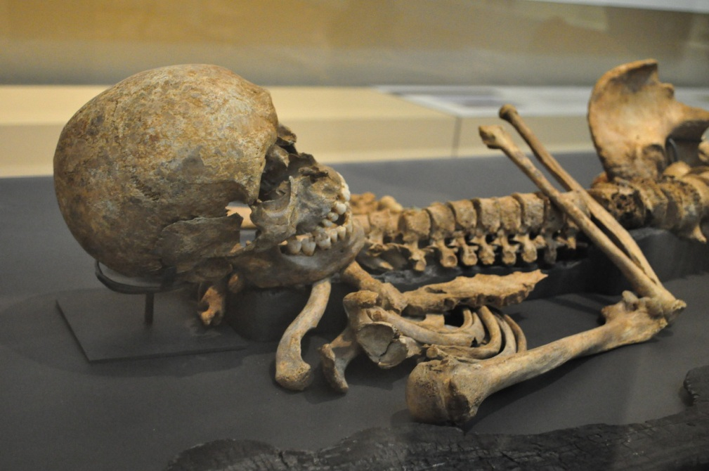

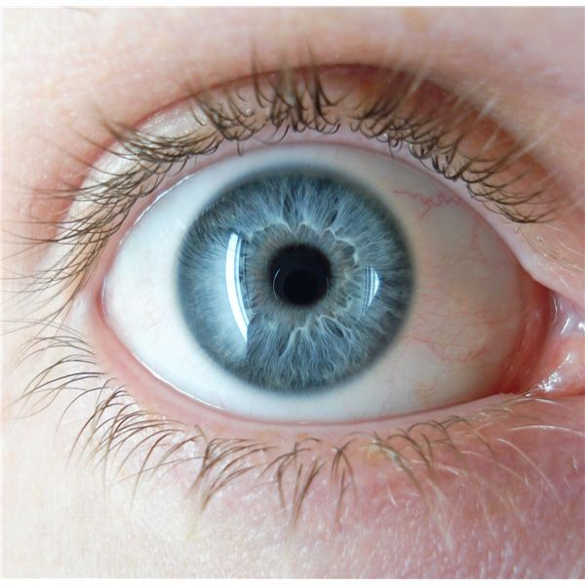
DNA conservation within Bone Tissue : prediction of human eye and hair color from skeletal remains
By Joel Sandé

Slide 2
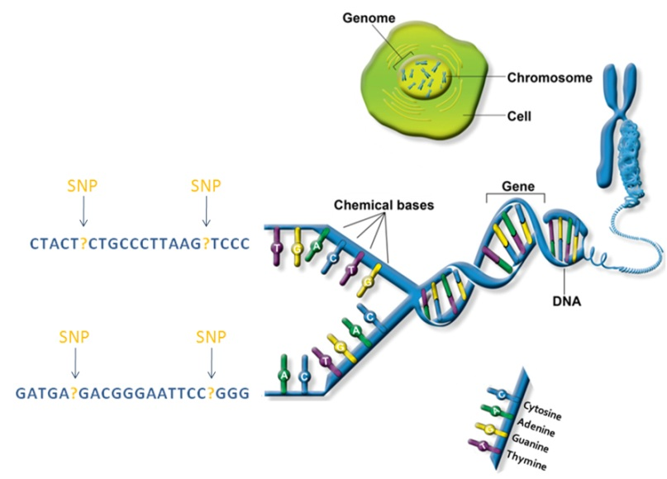

DNA within bone
Skeletal remains represent a unique type of biological material. Due to their unique feature, bone and teeth can be resistant to degradation and depending on the environmental storage condition, can provide a good source of DNA suitable for analyse THOUSAND OF YEAR after an organism death.
This paper shows that Colour of human eyes and hair can be reliably predicted using HIrisPlex system.
Analysis concerns short tandem repeats (STR) or microsatellites for direct match identification with STR profile of a huge genotype and phenotype database allowing parallel prediction of eyes and hair color.

Slide 3
Method
Sample collection
They analysed 26 specimens (21 teeth and 5 bones) classified S1 to S26
S1 to S3 were contemporary human remains collected 2 years after death.
S11 was the teeth of an army general (Wladislaw Sikorski dead in 1943) at 69 yrs.
S24 was the teeth of a woman that lived in the 14th century.
Precautions are taken to avoid contamination
DNA was isolated using a standard organic extraction protocol
15% bleach -> 70% ethanol -> drying -> UV irradiation -> -> -> 3g of bone powder for 1.5g of teeth -> incubation -> -> -> final volume of 70µl submitted to PCR to duplicate the DNA.
The analysis is performed using a database of thousands of Europeans and a convenient Microsoft Excel macro.

Slide 4
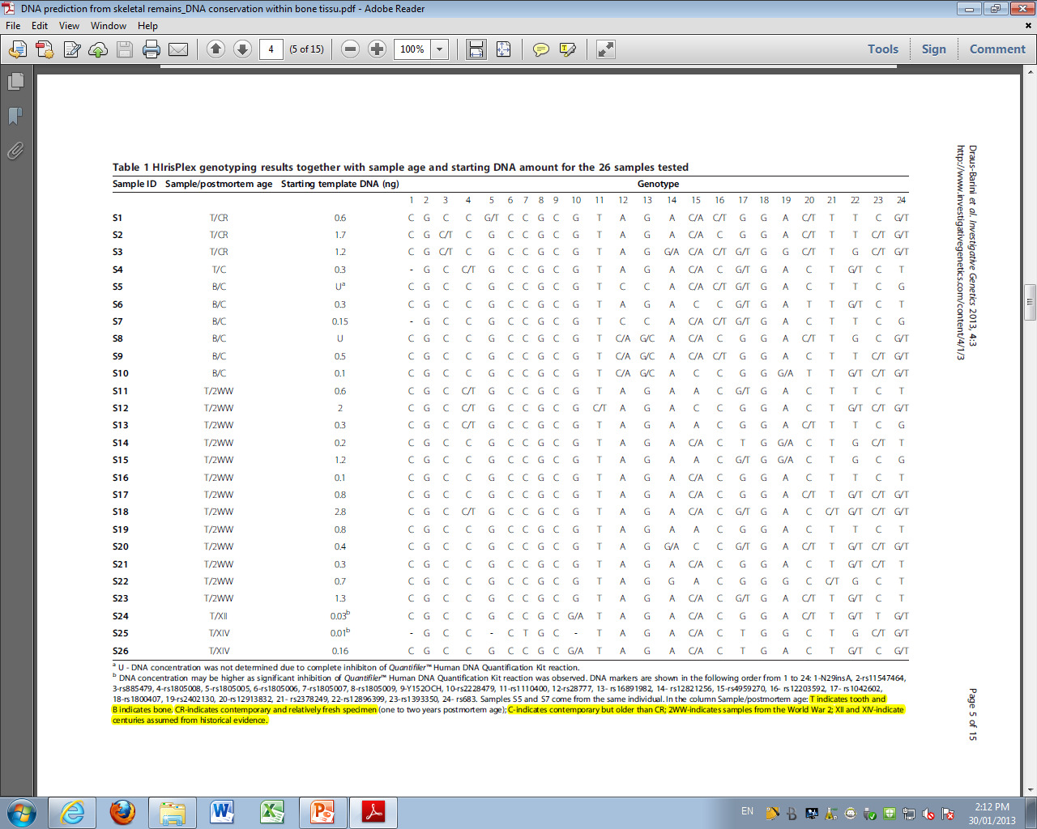
Results

Slide 5

Results

Slide 6
Discussion and criticism
A number of cases remain unsolved because of no match between the STR profile and the reference DNA profil database, low amount of DNA and very often heavy degradation.
The fact that (Wladislaw Sikorski) had blue eyes and blond hair as predicted via HIrisPlex was obtained from historical scripts.
The sequence is too short (that cannot expression a protein, not at all) If it’s true as it seems to be, that means that difference between black eye and blue eye is completely insignificant, however crucial

Slide 7
Conclusion
It can be anticipated that DNA prediction will soon because widely used in genetic studies of human remains.
The recently introduced HIrisPlex system provides a convenient molecular tools for simultaneous prediction of eyes and hair colours categories from Bones remains’s DNA.
As demonstrated here, HIrisPlex system is significantly sensitive to enable successful analyse of bones and teeth of various ages

Slide 8

reference
Jolanta Draus-Barini, Susan Walsh, Ewelina Pośpiech, Tomasz Kupiec, Henryk Głąb, Wojciech Branicki and Manfred Kayser. Bona fide colour : DNA prediction of human eye and hair colour from ancient and contemporary skeletal remains. Investigative Genetics. 2013. 4:3

